Slide 1
CH5 Overview

Slide 2
Agenda
History
Motivation
Cointegration
Applying the model
A trading strategy
Road map for strategy design

Slide 3

History
Now , we enter the second part of this book - Statistical Arbitrage Pairs
So we need to understand its development !
The first practice person : Nunzio Tartaglia (quantitative group)
Morgan Stanley in the mid 1980s.
Mission:
To develop quantitative arbitrage strategies using state-of-the-art
statisticaltechniques.
3. Today:
Pairs trading has since increased in popularity and has become a
common trading strategy used by hedge funds and institutional
investors.
Notes:
state-of-the-art 當代最尖端的意思 execute施行

Slide 4
Motivation
General trading:
To sell overvalued securities and buy the undervalued ones.
Is it possible to determine that a security is overvalued or undervalued? (Hard!)
Market is public , this opportunity can exist for a long time?
Pairs trading (resolve the problems) :
- Idea :
If two securities have similar characteristics, then the prices of both securities
must be more or less the same. If the prices happen to be different , it could
be that one of the securities is overpriced, the other security is underpriced.
- Trading:
1) The mutual mispricing between the two securities is captured by the notion of
spread.
2) Long-short position in the two securities is constructed by market neutral strategies.
So , the different between general and pairs trading is the “position” that determine by the
trader or market!

Slide 5
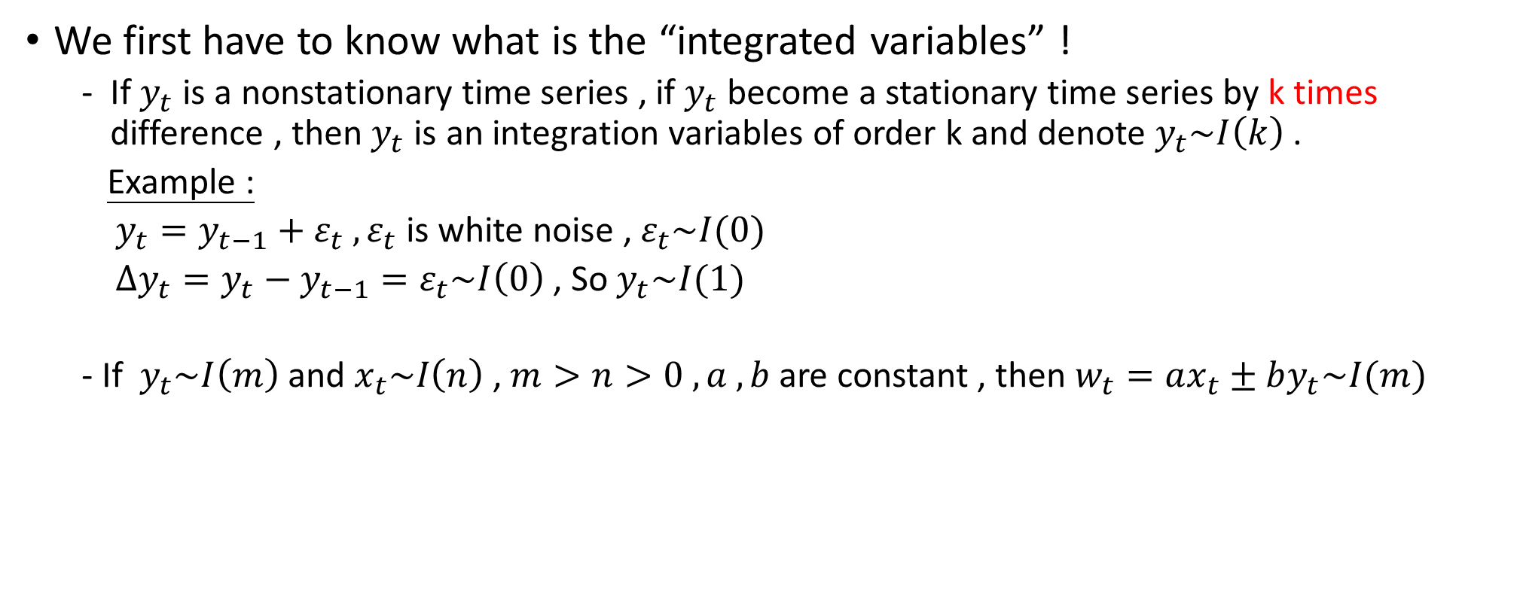
Cointegration
We first have to know what is the “integrated variables” !
If $y_{t}$ is a nonstationary time series , if $y_{t}$ become a stationary time series by k times difference , then $y_{t}$ is an integration variables of order k and denote $y_{t}\sim I\left(k\right)$ .
Example :
$y_{t}=y_{t−1}+ε_{t} , ε_{t}$is white noise , $ε_{t}\sim I(0)$
$∆y_{t}=y_{t}−y_{t−1}=ε_{t}\sim I\left(0\right)$ , So $y_{t}\sim I(1)$
- If $y_{t}\sim I\left(m\right)$and $x_{t}\sim I\left(n\right)$ , $m>n>0 , a , b$are constant , then $w_{t}=ax_{t}±by_{t}\sim I(m)$

Slide 6
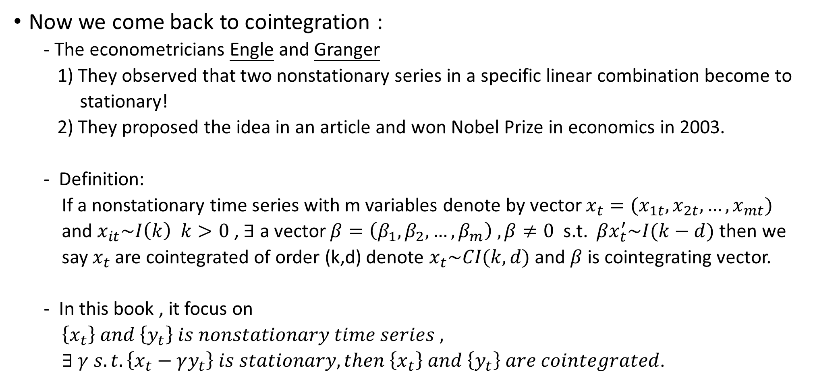
Cointegration
Now we come back to cointegration :
- The econometricians Engle and Granger
1) They observed that two nonstationary series in a specific linear combination become to
stationary!
2) They proposed the idea in an article and won Nobel Prize in economics in 2003.
Definition:
If a nonstationary time series with m variables denote by vector $x_{t}=(x_{1t},x_{2t},…,x_{mt})$
and $x_{it}\sim I\left(k\right) k>0$ , $∃$ a vector $β=\left(β_{1},β_{2},…,β_{m}\right) , β≠0$ s.t. $βx_{t}^{′}\sim I(k−d)$ then we
say $x_{t}$ are cointegrated of order (k,d) denote $x_{t}\sim CI(k,d)$ and $β$ is cointegrating vector.
In this book , it focus on
$\left\{x_{t}\right\} and \left\{y_{t}\right\} is nonstationary time series ,$
$∃ γ s.t. \left\{x_{t}−γy_{t}\right\} is stationary,then \left\{x_{t}\right\} and \left\{y_{t}\right\} are cointegrated$.

Slide 7
Cointegration
Real-life example :
Consumption and income
Short-term and long-term rates
The M2 money supply and GDP

Slide 8
Cointegration
So , What is the cointegrated series dynamics ?
The cointegrated systems have a long-run equilibrium.
- If there is a deviation from the long-run mean, then one or both time series adjust
themselves to restore the long-run equilibrium.(From Granger representation theorem)
We use “error correction” to capture the movement !

Slide 9
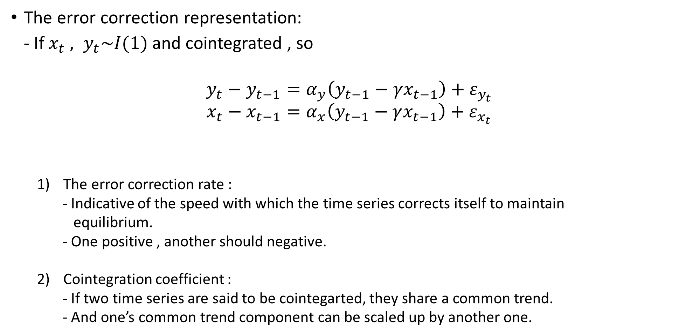
Cointegration
The error correction representation:
- If $x_{t} , y_{t}\sim I(1)$ and cointegrated , so
$$y_{t}−y_{t−1}=α_{y}\left(y_{t−1}−γx_{t−1}\right)+ε_{y_{t}}$$
$$x_{t}−x_{t−1}=α_{x}\left(y_{t−1}−γx_{t−1}\right)+ε_{x_{t}}$$
The error correction rate :
- Indicative of the speed with which the time series corrects itself to maintain
equilibrium.
- One positive , another should negative.
Cointegration coefficient :
- If two time series are said to be cointegarted, they share a common trend.
- And one’s common trend component can be scaled up by another one.
deviation from the long-run equilibrium
error correction rate
Error correction part
White noise part
Coefficient of cointegration

Slide 10
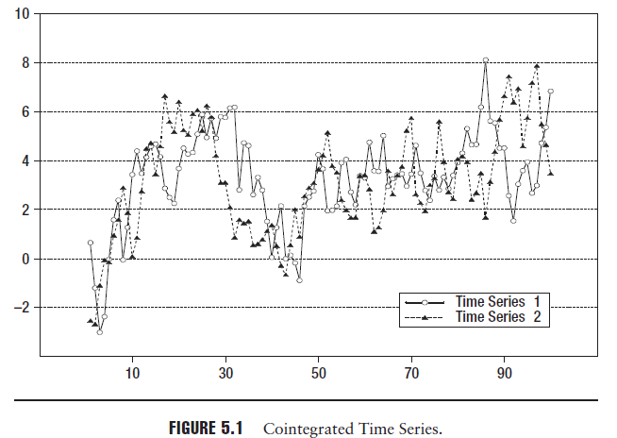

Slide 11
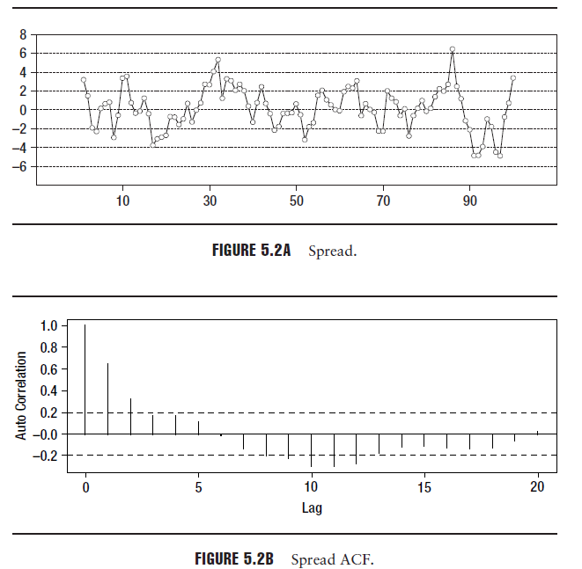

Slide 12

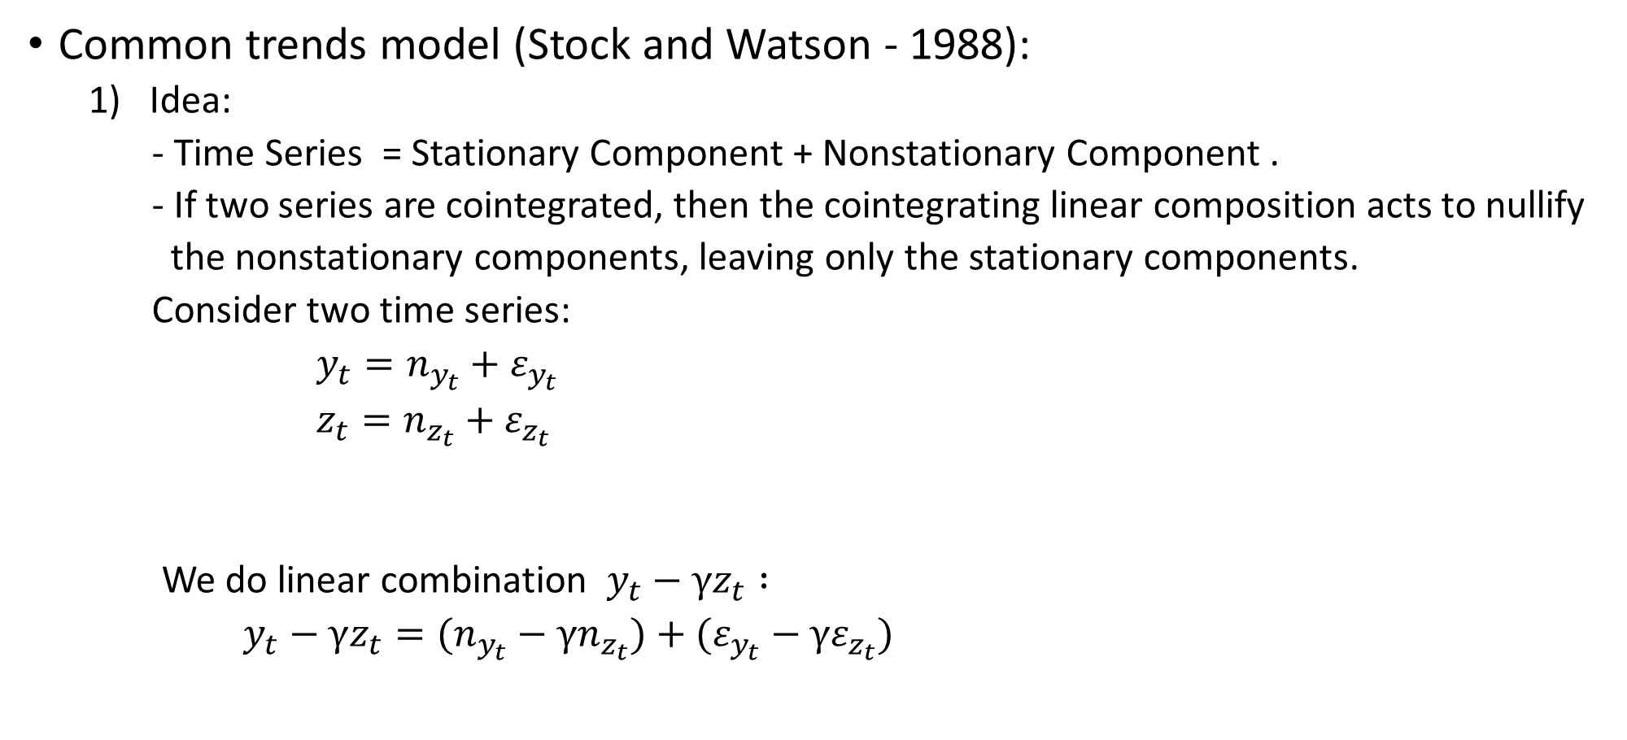
Cointegration
Common trends model (Stock and Watson - 1988):
Idea:
- Time Series = Stationary Component + Nonstationary Component .
- If two series are cointegrated, then the cointegrating linear composition acts to nullify
the nonstationary components, leaving only the stationary components.
Consider two time series:
$y_{t}=n_{y_{t}}+ε_{y_{t}}$
$z_{t}=n_{z_{t}}+ε_{z_{t}}$
We do linear combination $y_{t}−γz_{t} :$
$y_{t}−γz_{t}=(n_{y_{t}}−γn_{z_{t}})+(ε_{y_{t}}−γε_{z_{t}})$
Stationary components of the time series.
Random walk (nonstationary) components
Should be zero , so $n_{y_{t}}=γn_{z_{t}}$

Slide 13

Applying the model
Let us fit the cointegration model to the logarithm of stock prices.
Assumption:
- Logarithm of stock prices is random walk (nonstationary).
It means $\left\{log\left(P_{t}^{A}\right)\right\} and \left\{log\left(P_{t}^{B}\right)\right\}$ is nonstationary.
The error correction representation:
Return of the stocks in the current time period.
Difference of the logarithm of price and the expression for the long-run equilibrium.
Spread
Use past information to predict future
The past deviation from equilibrium plays a role in deciding
the next point in the time series.

Slide 14
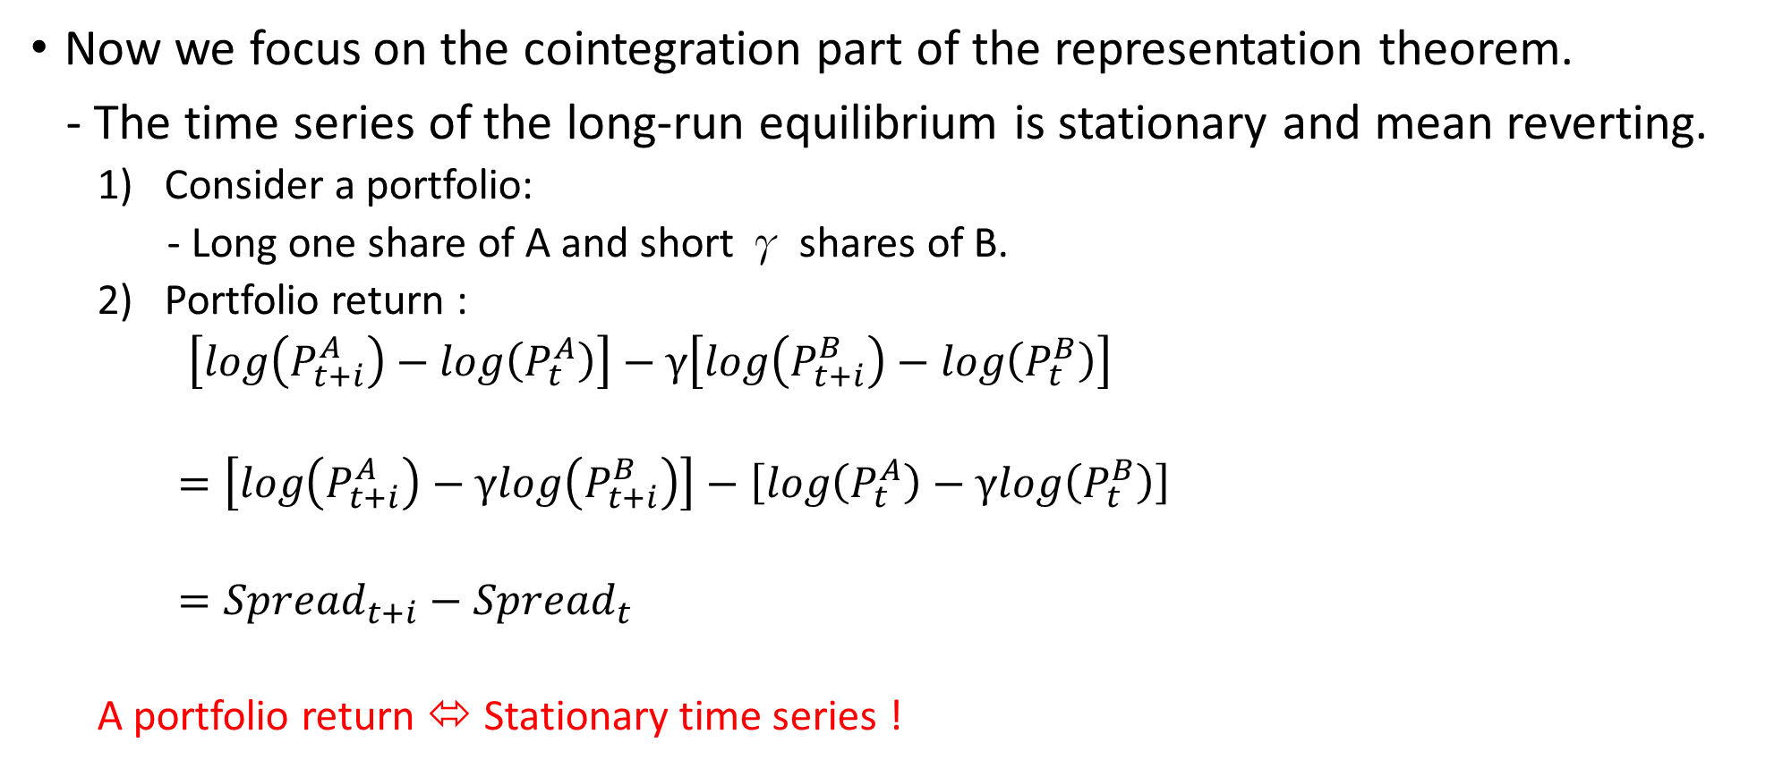
Applying the model
Now we focus on the cointegration part of the representation theorem.
- The time series of the long-run equilibrium is stationary and mean reverting.
Consider a portfolio:
- Long one share of A and short γ shares of B.
Portfolio return :
$\left[log\left(P_{t+i}^{A}\right)−log\left(P_{t}^{A}\right)\right]−γ\left[log\left(P_{t+i}^{B}\right)−log\left(P_{t}^{B}\right)\right]$
$=\left[log\left(P_{t+i}^{A}\right)−γlog\left(P_{t+i}^{B}\right)\right]−\left[log\left(P_{t}^{A}\right)−γlog\left(P_{t}^{B}\right)\right]$
$={Spread}_{t+i}−{Spread}_{t}$
A portfolio return ⬄ Stationary time series !

Slide 15
A trading strategy
A simple trading strategy :
- Deviation from the equilibrium value : Put on the trade.
- Restore the equilibrium value : Unwind the trade.
The equilibrium value is also the mean value of the series.

Slide 16
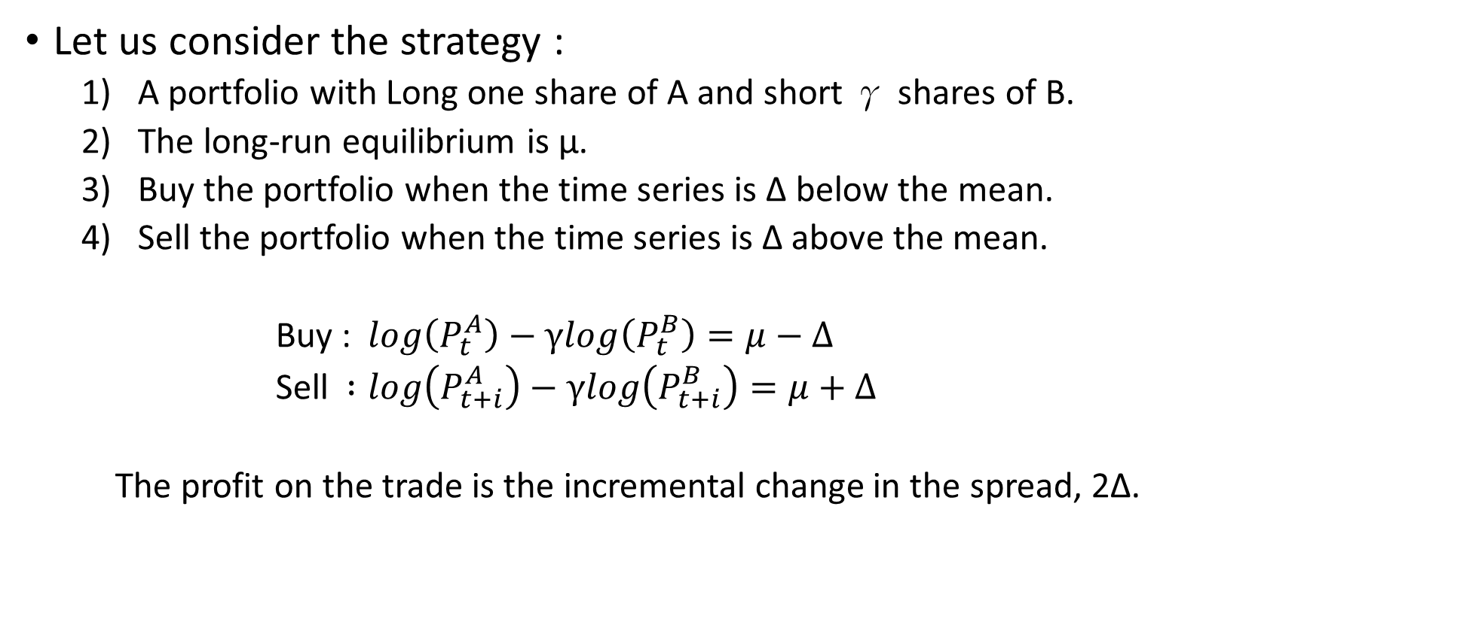
A trading strategy
Let us consider the strategy :
A portfolio with Long one share of A and short γ shares of B.
The long-run equilibrium is μ.
Buy the portfolio when the time series is Δ below the mean.
Sell the portfolio when the time series is Δ above the mean.
Buy : $log\left(P_{t}^{A}\right)−γlog\left(P_{t}^{B}\right)=μ−Δ$
Sell $:log\left(P_{t+i}^{A}\right)−γlog\left(P_{t+i}^{B}\right)=μ+Δ$
The profit on the trade is the incremental change in the spread, 2Δ.

Slide 17
A trading strategy
Example:
Consider two stocks A and B that are cointegrated with the following data:
Cointegration Ratio = 1.5
Delta used for trade signal = 0.045
Bid price of A at time t = $19.50
Ask price of B at time t = $7.46
Ask price of A at time t + i = $20.10
Bid price of B at time t + i = $7.17
Average bid-ask spread for A = .0005 (5 basis points)
Average bid-ask spread for B = .0010 ( 10 basis points)

Slide 18
A trading strategy
Strategy:
We first examine if trading is feasible given the average bid-ask spreads.
Average trading slippage = ( 0.0005 + 1.5 × 0.0010) = .002 ( 20 basis points).
This is smaller than the delta value of 0.045. Trading is therefore feasible.
At time t, buy shares of A and short shares of B in the ratio 1:1.5.
Spread at time t = log (19.50) – 1.5 × log (7.46) = –0.045.
At time t + i , sell shares of A and buy back shares the shares of B.
Spread at time t + i = log (20.10) – 1.5 × log (7.17) = 0.045.
Total return = return on A + γ× return on B
= log (20.10) – log(19.50) + 1.5 × (log(7.46) – log(7.17) )
= 0.3 + 1.5 × 4.0
= .09 (9 percent)

Slide 19
Road map for strategy design
Step 1
Identify stock pairs that could potentially be cointegrated.
Based on the stock fundamentals
Alternately on a pure statistical approach based on historical data.
- This book preferred (1).
Step 2
The stock pairs are indeed cointegrated based on statistical evidence from historical data.
- Determining the cointegration coefficient and examining the spread time
series to ensure that it is stationary and mean reverting.
Step 3
Examine the cointegrated pairs to determine the delta.

